Slide 1


BioProcess Technology (BT-CH6460)
DEVARAI SANTHOSH KUMAR
BioProcess Technology
Slot: B: CH6460
Gmeetlink: https://meet.google.com/dgo-gcwf-dfs

Slide 2
OUTLINE OF BT
Theory
Equation derivation
Problem solving
Bioenzymes kinetics (Growth and Enzyme)
Fermentation development
Immobilization and its Downstream purification
Mass Transfer in bioprocessing
Rheology of fermentation broth
Oxygen demand, types
Bioreactor and Fermentation
Recombinant monoclonal technology
Marine-derived biomaterials, Pharmaceutical, Molecular biology and Tissue engineering
End-Exam and Assignment collection (Tentative date December)
Text Books
Se-Kwon Kim: Marine Biomaterials: Characterization, Isolation, and Applications, CRC Press
Douglas S Clark and HW Blanch, Biochemical Engineering, Second Edition, CRC Press
Bailey and Ollis: Biochemical Engineering Fundamentals, McGraw-Hil
Bioprocess Engineering: Basic Concepts, by Michael L. Shuler, Prentice Hall, 2001
Net Source

Slide 3
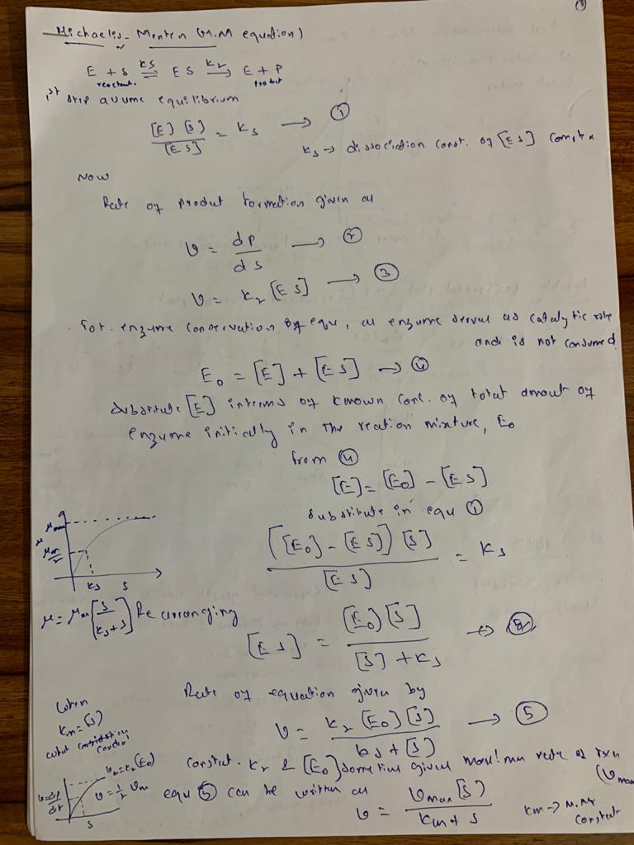
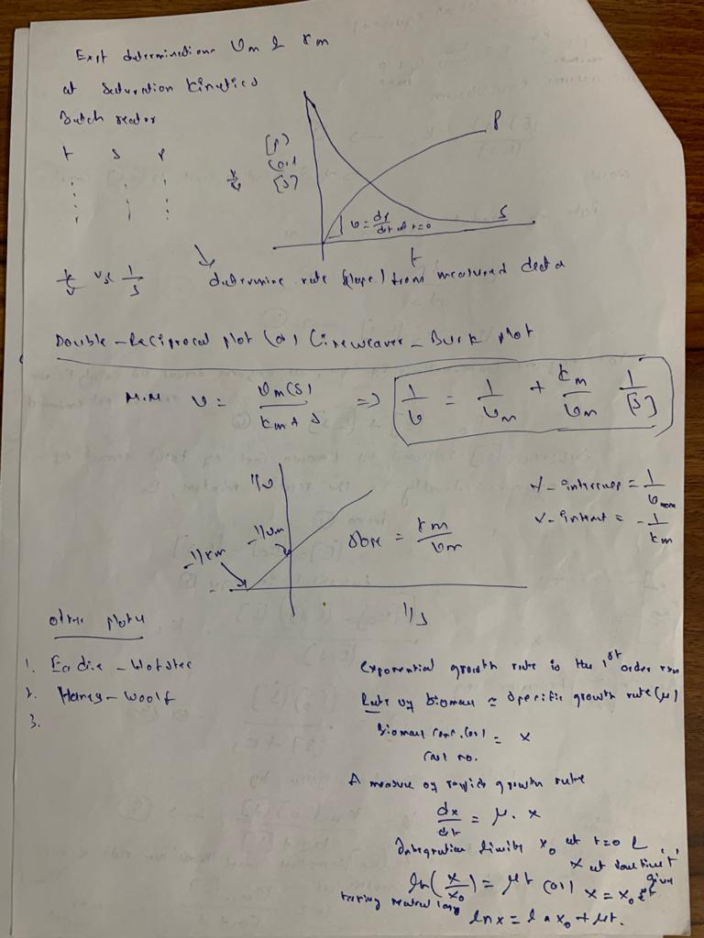

Slide 4
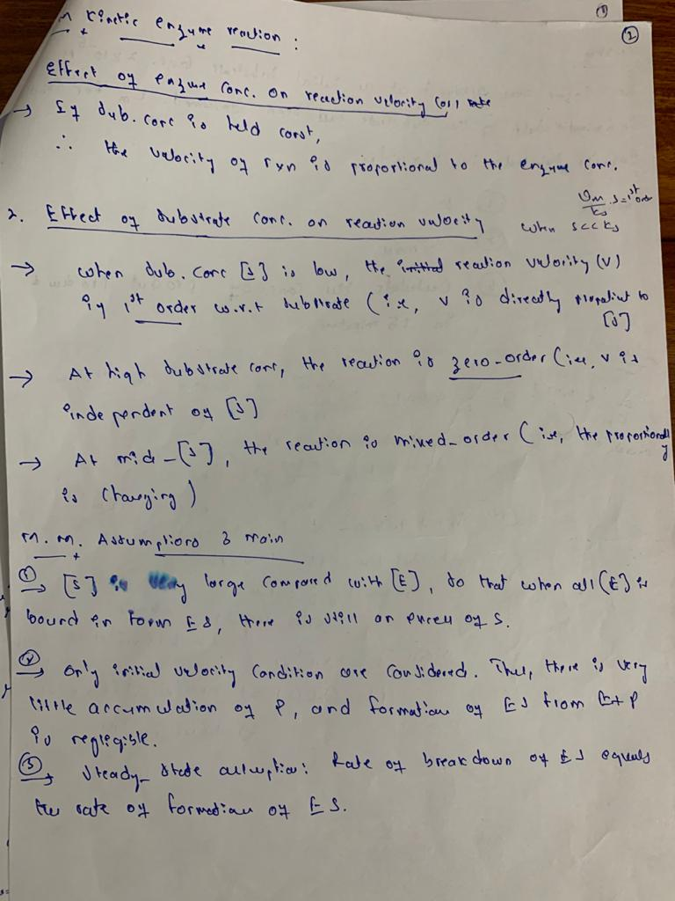
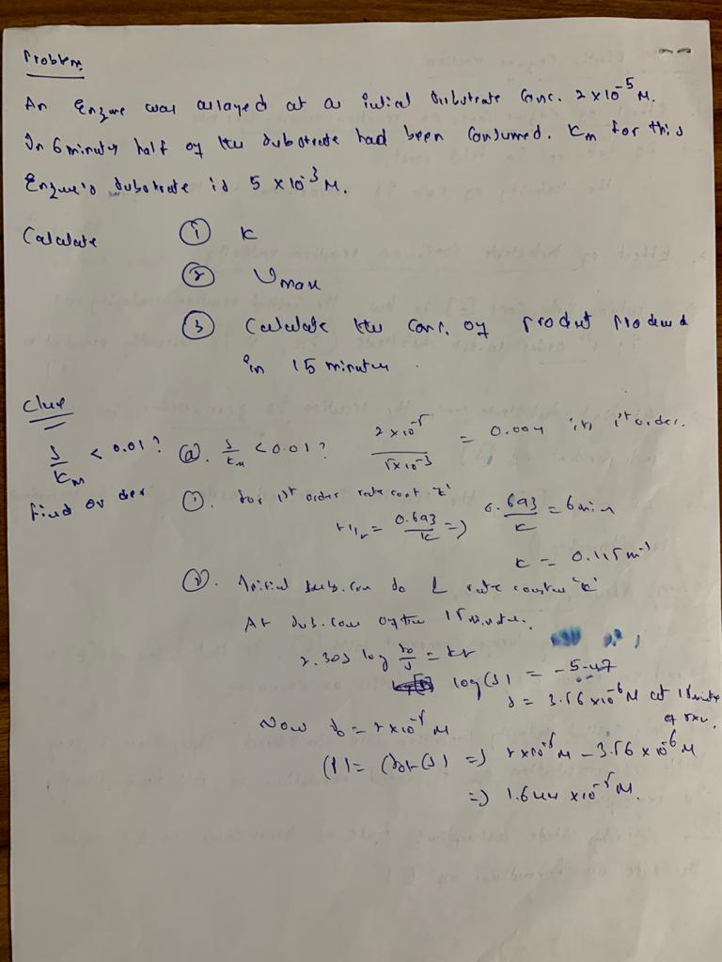

Slide 5
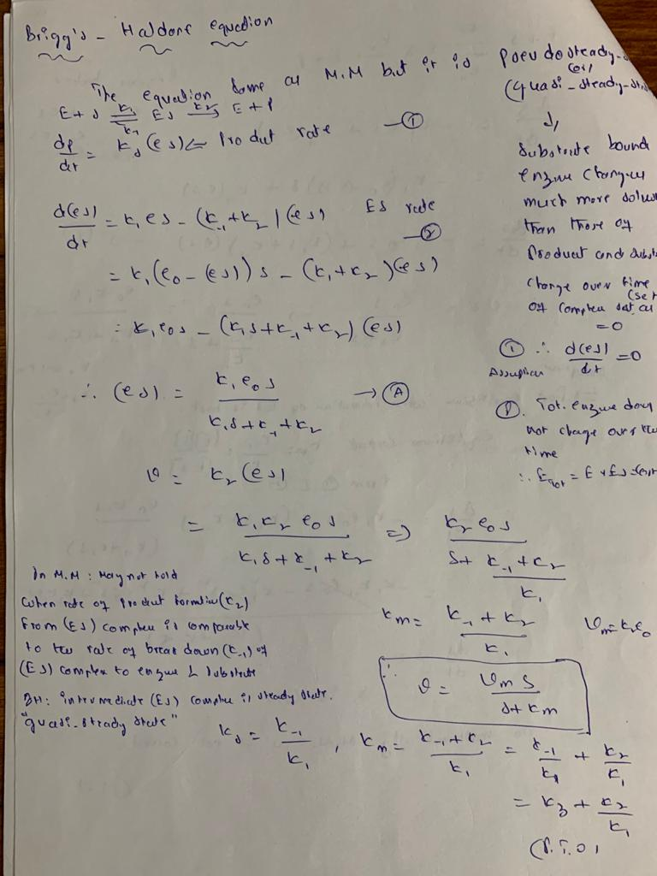
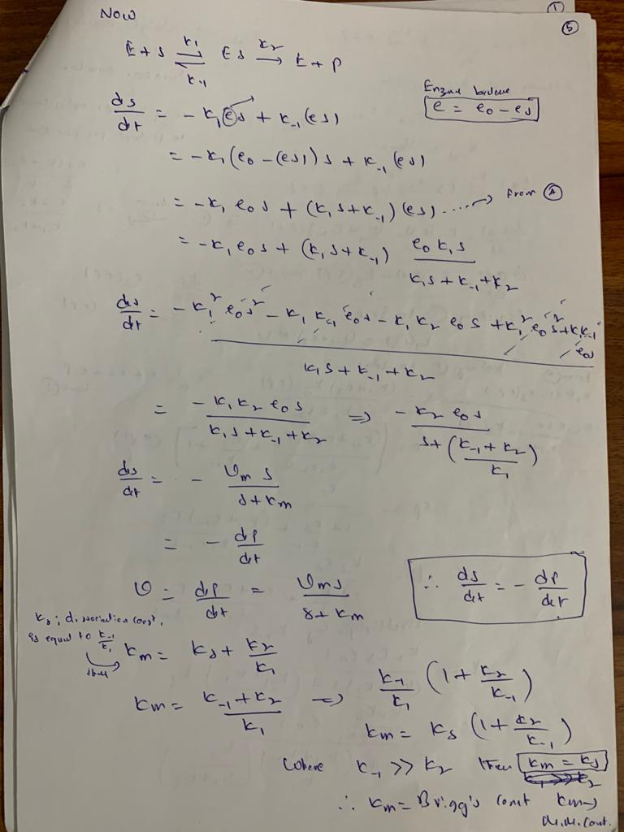

Slide 6
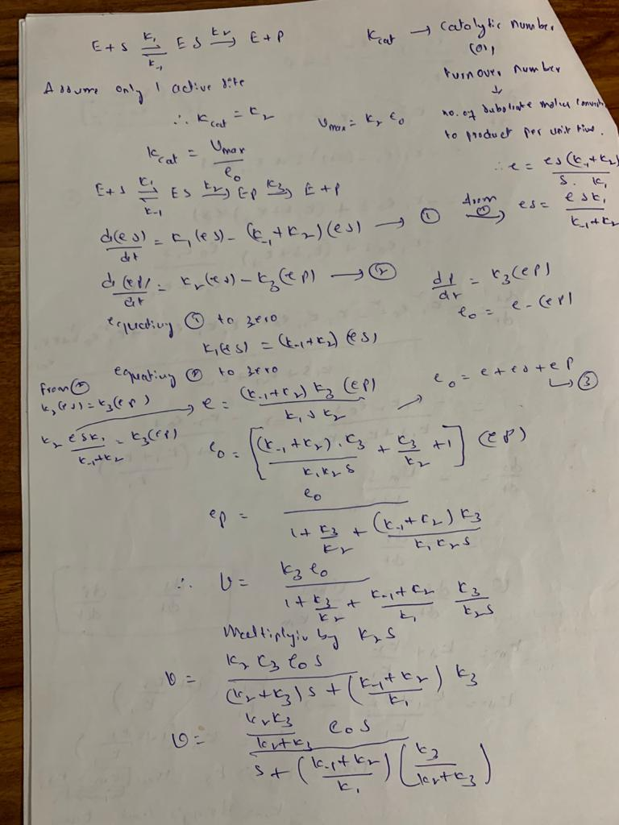
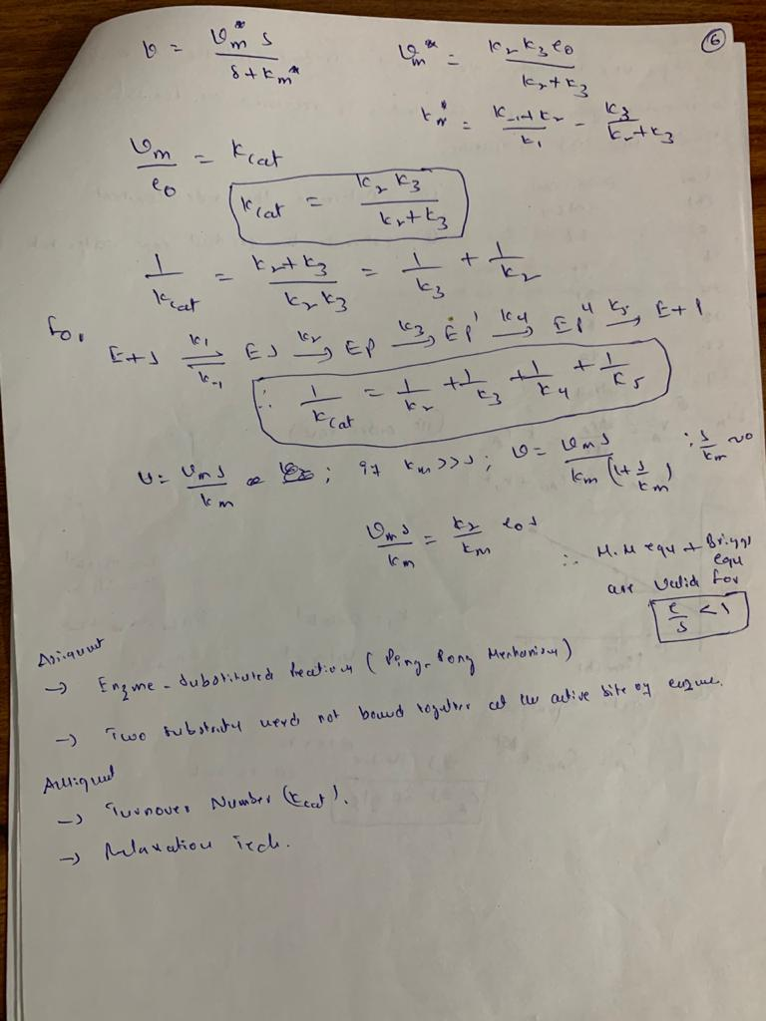

Slide 7
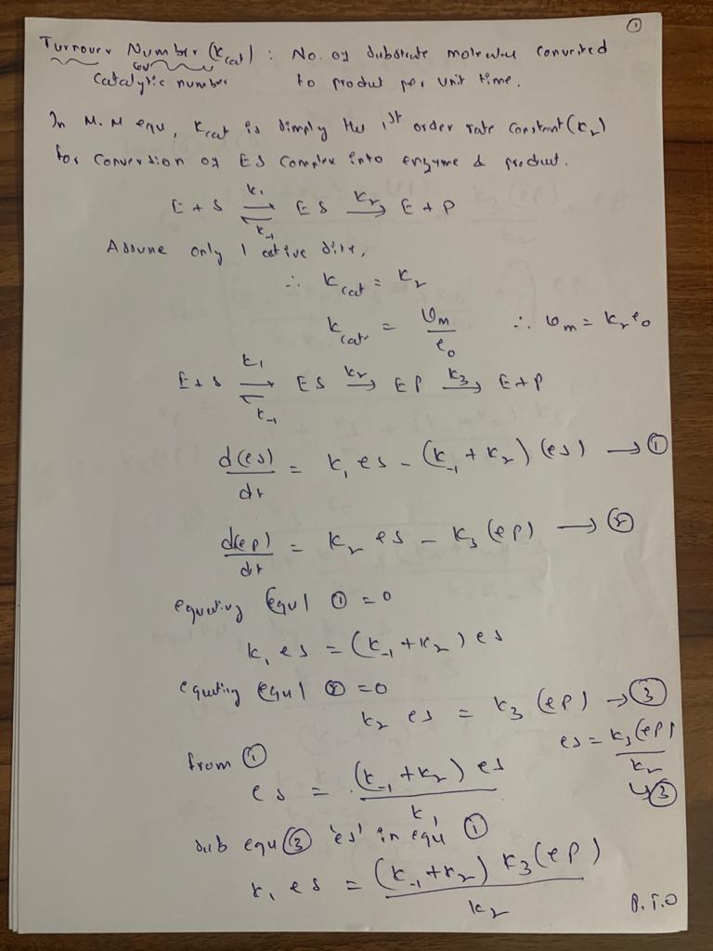
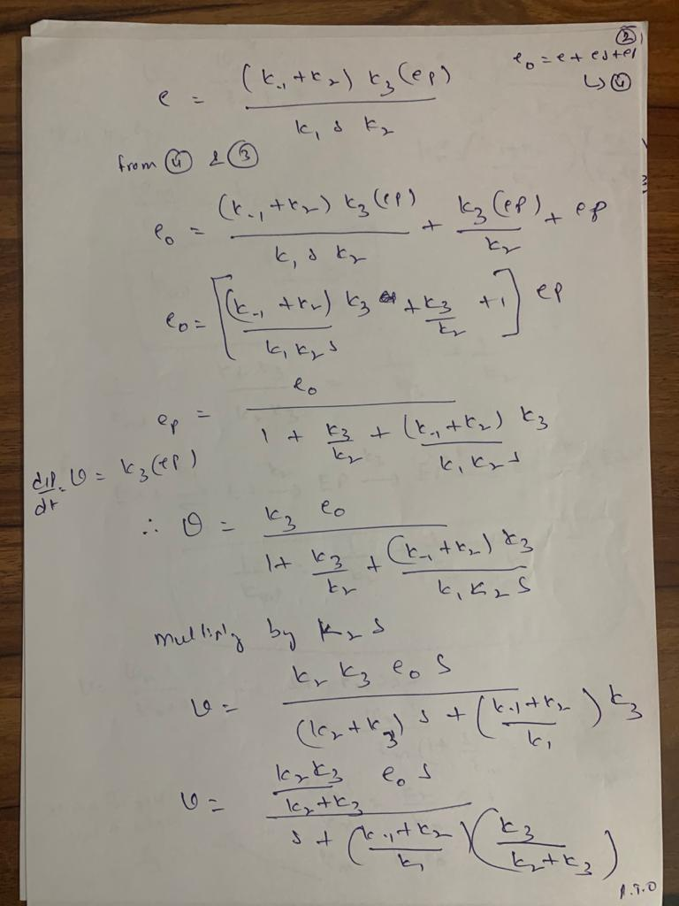

Slide 8
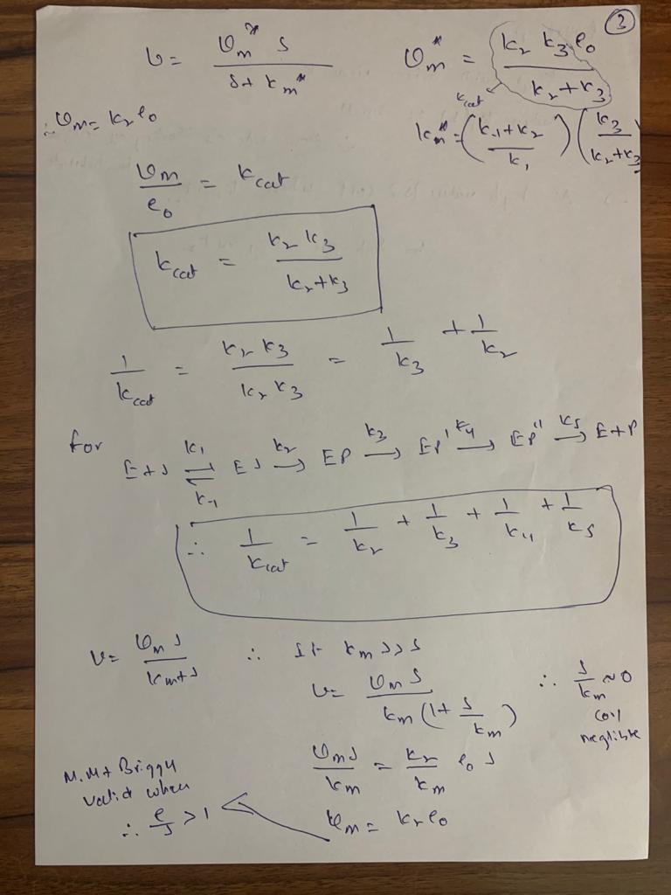
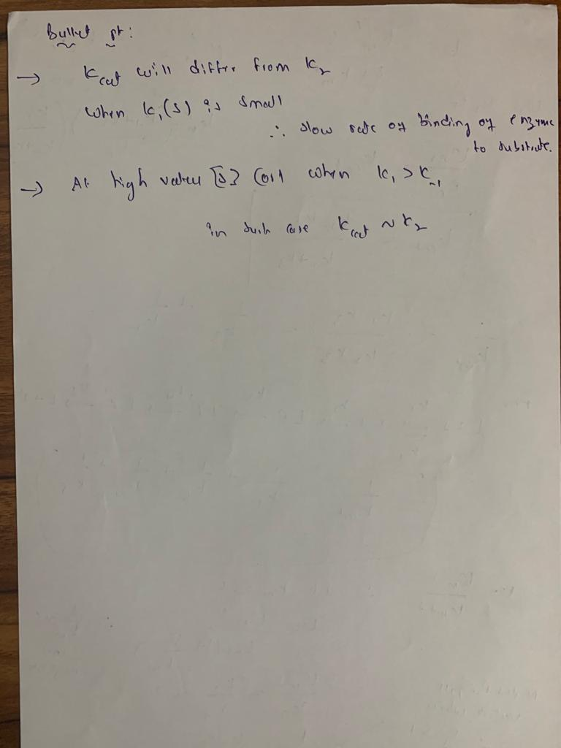

Slide 9
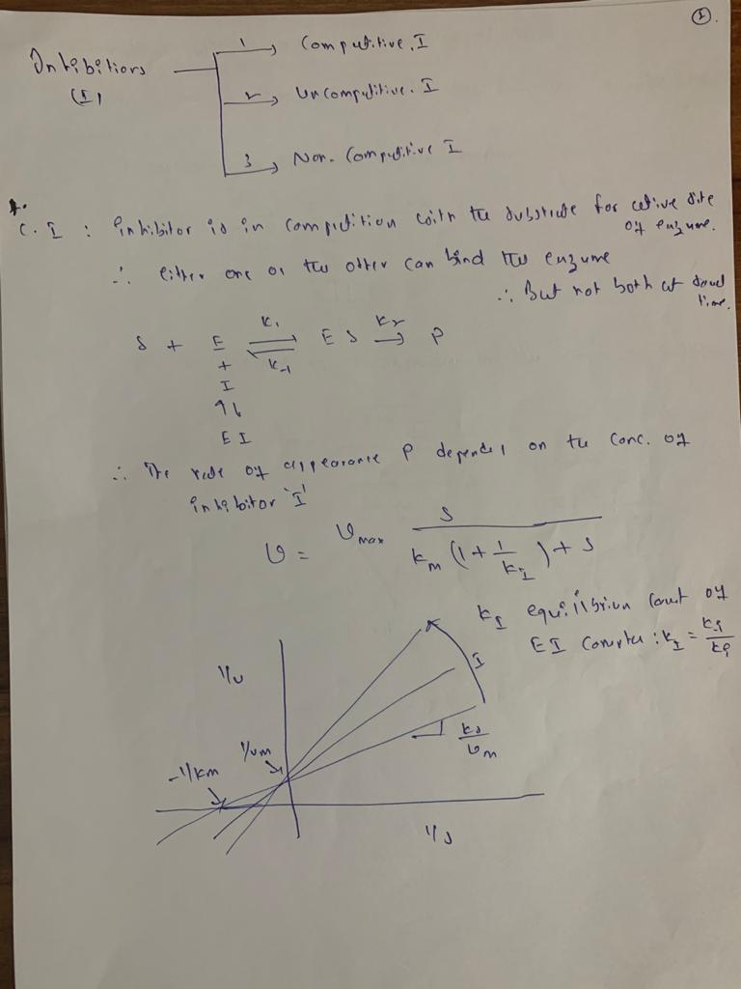
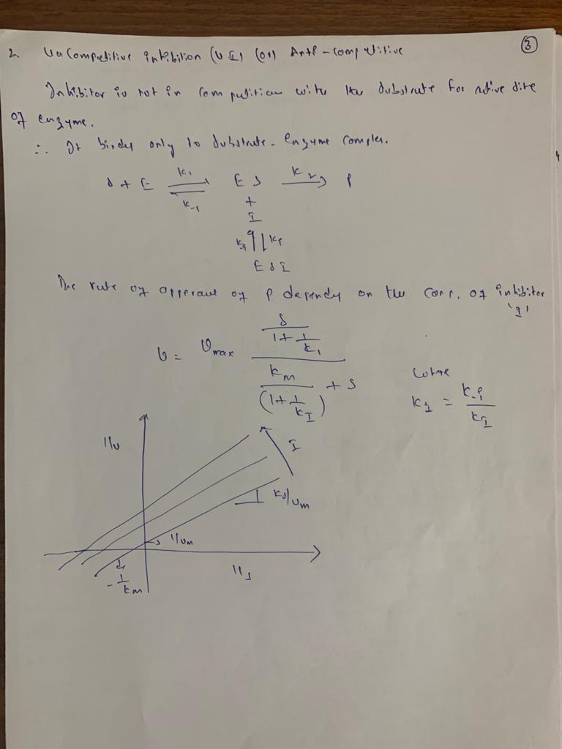

Slide 10
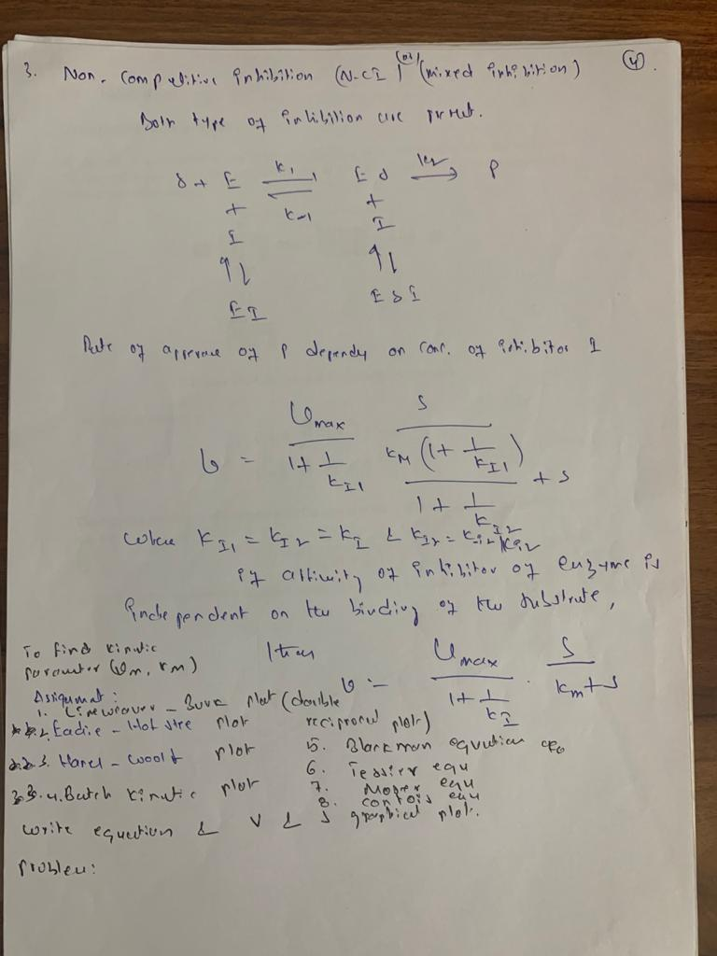

Slide 11
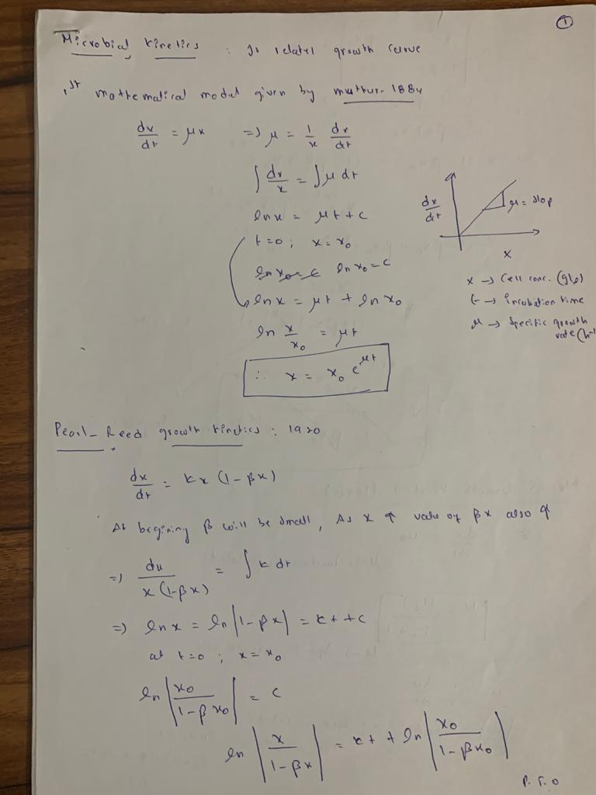
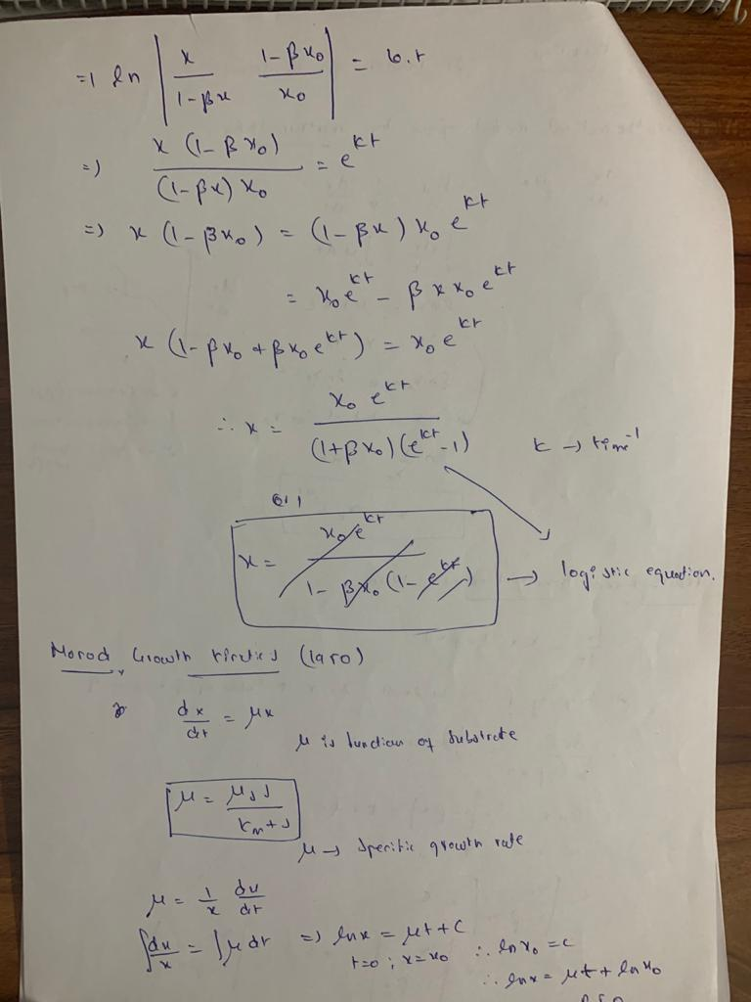

Slide 12
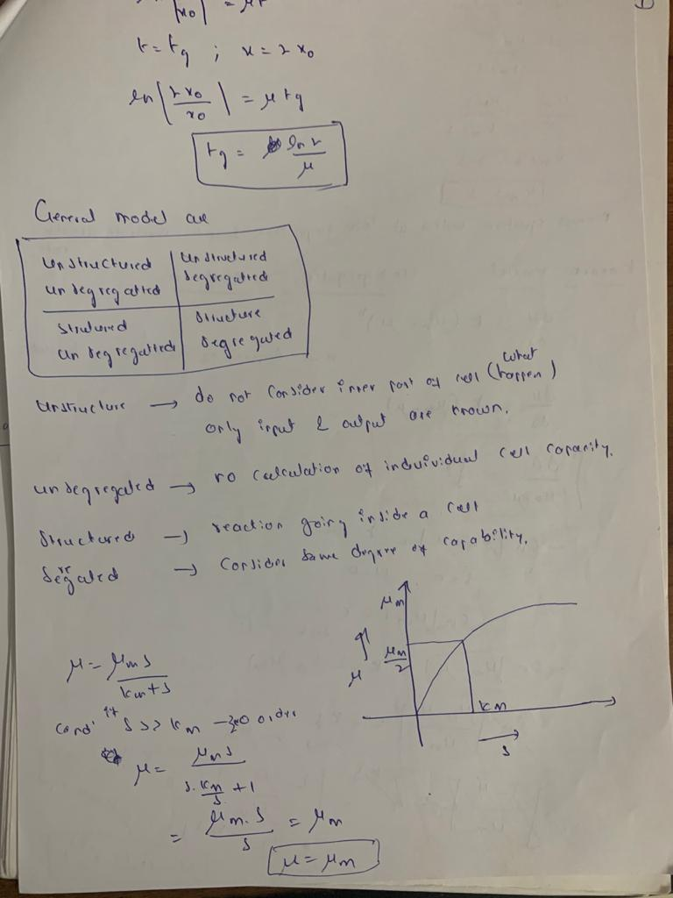
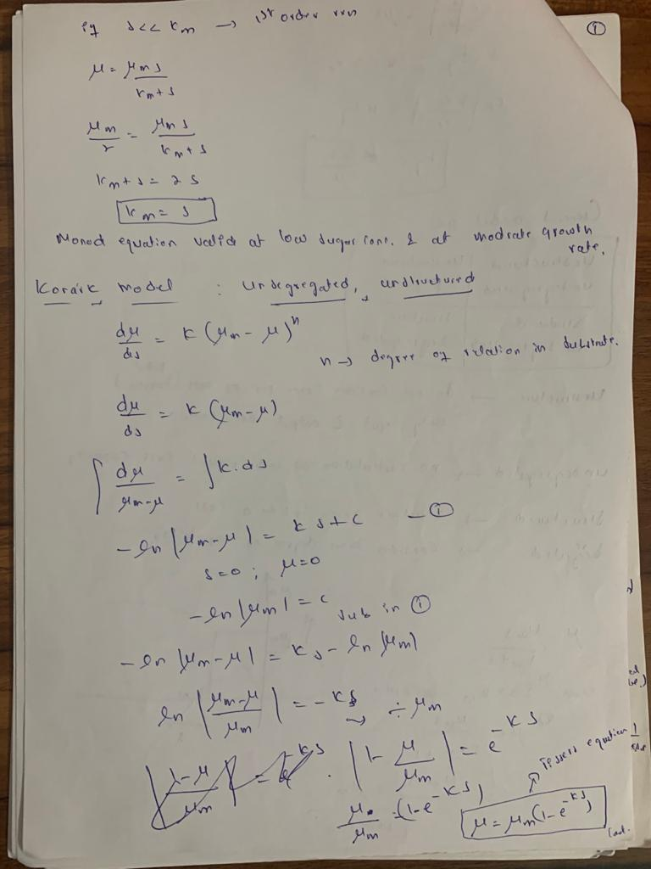

Slide 13
